Slide 2
European Molecular Imaging Doctoral School

Slide 3
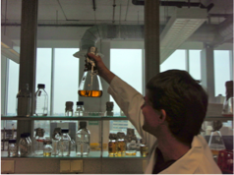
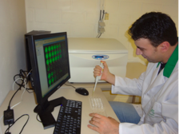
European Molecular Imaging Doctoral School
Academic
Industry
Molecular Imaging Professional
Expert training in Molecular Imaging
Promote PhD student mobility

Slide 4
European Molecular Imaging Doctoral School
Biomedical Sciences, Bioengineering, Bioinformatics, Chemistry, Physics, Pharmacy, Medicine, EMMI,….
EMIDS Whom?

Slide 5
European Molecular Imaging Doctoral School
EMIDS 2-3 year program or more
3-6 months
training abroad
Active participation
@ EMIM meetings
Molecular
Imaging workshops
Doctoral
dissertation

Slide 6
European Molecular Imaging Doctoral School
EMIDS 180 ECTS
Expert training
10 ECTS/month
(min 30-max 60 ECTS)
EMIM
Poster: 10 ECTS Oral: 20 ECTS
(min 40 ECTS)
MI workshops
5 ECTS/workshop
(min 10- max 20 ECTS)
Doctoral dissertation
100 ECTS

Slide 7
European Molecular Imaging Doctoral School
Advantage for students:
Expert training/feedback
Mobility
Improved visibility
Improved employability
Network
Advantage for research team:
EU network for grant applications
Improved Quality of PhD
Joint PhD/ Double PhD
Internationalization
Attract PhD student to workshops

Slide 8
European Molecular Imaging Doctoral School
EMIDS sessions at EMIM
Oral presentations (5/year)
Poster presentations
PhD presentations
Feedback from EMIDS jury
EMIDS Website/Forum
Workshop announcements
Online Education
Grant opportunities
EMIDS PhD Presentations and thesis
EMIDS support
EMIDS diploma supplement
Joint or double degree
EMIDS fund raising for mobility
Industry
EU Grants (Cost, Marie Curie, …)

Slide 9
European Molecular Imaging Doctoral School
EMIDS Budget ?
EMIDS grants offered by Universities
- for incoming or outgoing students
- EMIDS partners
EU funding programs
- COST, Marie Curie
National networks & societies
- Ireland: NBIP
- France: FLI?
ESMI
Industry

Slide 10
European Molecular Imaging Doctoral School
Start in 2nd year of PhD
1st generation in Oct 2014
EMIDS When?

Slide 11
European Molecular Imaging Doctoral School
EMIDS extending the network!! Now

Slide 12
European Molecular Imaging Doctoral Schools Network
www.emids.eu

