Slide 1
BioClinica – Imaging Your Career
Chahin PACHAI, Ph.D.
September 24, 2014

Slide 2
Agenda
Introduction, Overview of BioClinica
Start-up experience: Theralys
Imaging in Clinical Research: Goals and Typical Services
Imaging CROs: Recent Evolutions & Current Market Trends

Slide 3
Introduction / Bio
Chahin Pachai, Ph.D.
BioClinica VP and Executive Director
Education
INSA de Lyon, Electrical Engineering
Ph.D. (Evaluation of Multiple Sclerosis in MRI) – CREATIS (CNRS Research Unit, Lyon) & Surgical Planning Laboratory (Harvard Medical School, Boston)
Ecole de Management (EM) de Lyon (entrepreneurship course)

Slide 4
BioClinica Overview
BioClinica, Inc. is a global provider of technology-enhanced clinical trial solutions.
BioClinica supports the Medical Imaging, eClinical, and Cardiac Safety needs of clinical trials.
A leader in the industry, BioClinica’s technology is enhanced with scientific, operational, and regulatory expertise garnered over 29 years of experience supporting more than 3,300 clinical trials.
Websites:
http://www.bioclinica.com/
http://www.bioclinica.com/about/careers

Slide 5
BioClinica Overview
Imaging Solutions
Cardiac Safety
eClinical Solutions
Scientific Consultation
Site Standardization
Image Collection & QC
Electronic Image Transfer & Archive
Independent Image Review
Centralized ECG/Holter
Thorough QT
Ambulatory Blood Pressure
Telemedicine
Pulse Wave Analysis
EDC
CTMS
IWR/IVRS
Trial Supplies Management
Data Management
Notes:
BioClinica, Inc.
5

Slide 6
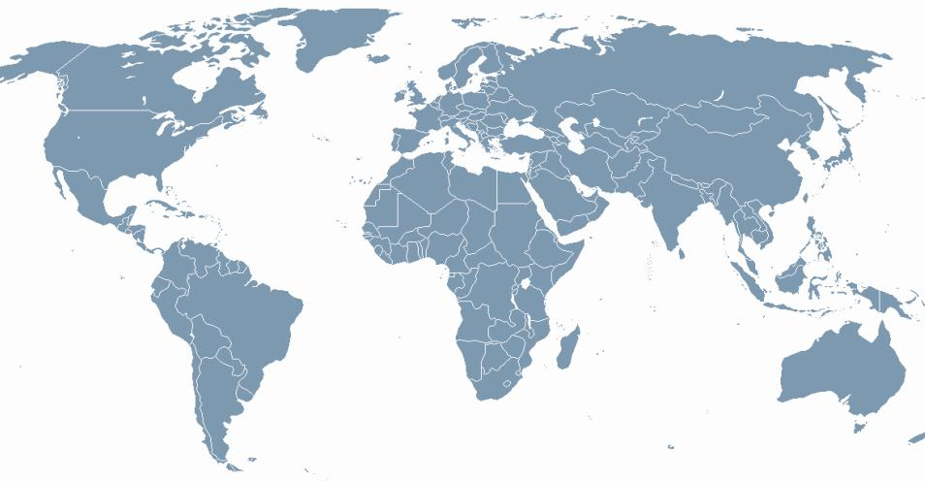
BioClinica Overview
Leiden
Hamburg
Portland
London
Munich
Beijing
Princeton & Newtown
Lyon
Tokyo
Newark
Shanghai
Bone & MSK
Newark, CA, USA
Newtown, PA , USA
Portland, OR, USA
London, UK
Hamburg, Germany
Beijing, China
Metabolic, GI & Pain
Newtown, PA , USA
Newark, CA, USA
Portland, OR, USA
Leiden, The Netherlands
Neurosciences
Newark, CA, USA
Newtown, PA USA
London, UK
Lyon, France
Cardiovascular
Princeton, NJ, USA
Newark, CA, USA
Shanghai, China
Oncology
Princeton, NJ, USA
Newark, CA, USA
Munich, Germany
Shanghai, China
Tokyo, Japan
Notes:
BioClinica, Inc.
6

Slide 7
From Theralys to BioClinica (1/2)
2001 Incorporation of Theralys SA in Lyon (4 founders)
2002 Fundraising EUR 550.000 involving regional institutional venture capitals (Rhône-Alpes, France)
2002 ANVAR (Banque Publique d’Investissement) EUR 400.000 interest free loan (of which EUR 280.000 were used)
2004 Beginning of collaboration with Bio-Imaging Technologies (co-marketing, revenue sharing, advanced image analyses services performed by Theralys)
2005 Backlog at EUR 4M, signature of first phase III study
2006 Preparation of a new round of funding (EUR 3M) in parallel with an acquisition offer from Bio-Imaging Technologies
2007 Acquisition of Theralys by Bio-Imaging Technologies (10 employees in 2007)
2007 – 2014 35+ clinical trials in Central Nervous Disease indications, mainly Alzheimer Disease (32 employees in 2014)

Slide 8
From Theralys to BioClinica (2/2)
2009 Bio-Imaging Technologies became BioClinica.
2009 Addition of an eClinical Division (CTMS, IVR, EDC services)
2013 BioClinica was acquired by a US-based investment firm and went private, merger with Core Lab Partners (imaging CRO specialized in oncology)
2014 BioClinica merged with Synarc (approximately 1000 employees)

Slide 9
Imaging in Clinical Research: Main Actors
Main actors of clinical research studies funded industry:
Pharmaceutical companies sponsoring clinical studies (phase I – IV)
Clinical centers (investigators) implementing the clinical research protocols on subjects they recruit
Subjects who accept to participate in clinical studies
Clinical Research Organization (CRO), companies such as Quintiles, Covance, Parexel, PRA, World Wide Clinical Trials, etc.
Imaging CRO, a niche within the CRO market, dedicated to the management of the imaging component of clinical trials (BioClinica)
Regulatory agencies (FDA, EMA)

Slide 10
Imaging in Clinical Research: Goals: Efficacy, Safety & Eligibility
Evaluation of Efficacy
RECIST, CHESON, RANO Criteria in oncology
Number, volume and activity of lesions in Multiple Sclerosis
Brain, ventricular and hippocampal atrophy in neuro-degenerative diseases
Evaluation of safety
Absence of new abnormalities induced by the treatment with or without association with occurrence of new symptoms
Patient Eligibility
Reduction of the “placebo” effect
Selection of more informative subjects or those who would better respond to a given treatement

Slide 11
Typical MRI Scans in CNS Studies

Slide 12
Site Quality Assurance

Slide 13
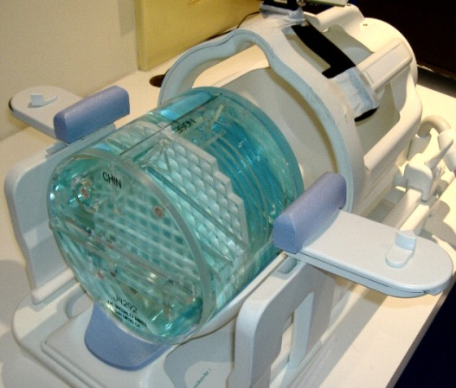
Site Quality Assurance (MRI)
center of the phantom
Phantom scan QC
Acquisition parameters
Geometric accuracy with which the image represents lengths in the imaged subject
MRI signal intensity inhomogeneity (uniformity of the image intensity over a large water-only region of the phantom)
Level of ghosting artefact in the images
Detectability for high/low contrast objects
chin
nose

Slide 14
Typical Process Flow
Site Qualification & Training
MRI & PET Data
Collection & QC
Central Eligibility / Safety Reads
MRI & PET Data
Processing/Efficacy
Export of Evaluation Results

Slide 15
Typical Quantitative Assessments in Neuro Studies
Image Processing for Quantitative Analyses (MRI)
3D image registration
Correction of MRI signal intensity inhomogeneity
Quantification of intracranial volume
Quantification of hippocampal volume
Quantification of brain, ventricular and hippocampal atrophy using Boundary Shift Integral (BSI) and/or Tensor Based Morphometry (TBM)
Quantification of regional atrophy
Quantification of cortical thickness
Diffusion Tensor Imaging (DTI)

Slide 16
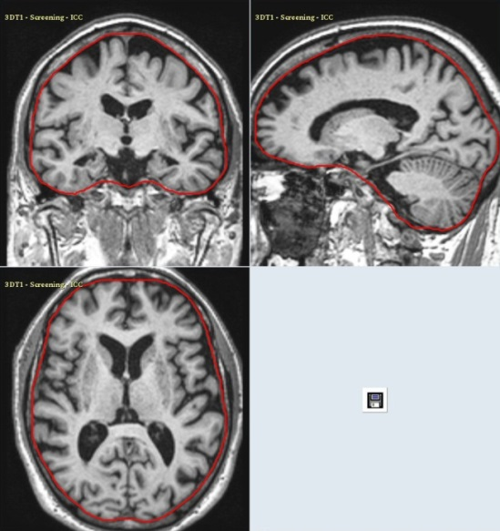
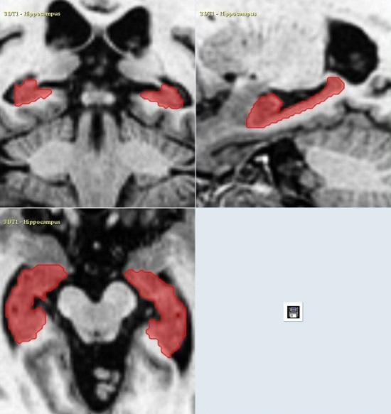
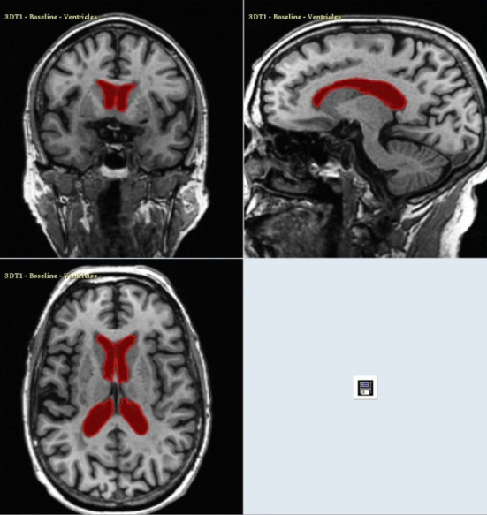
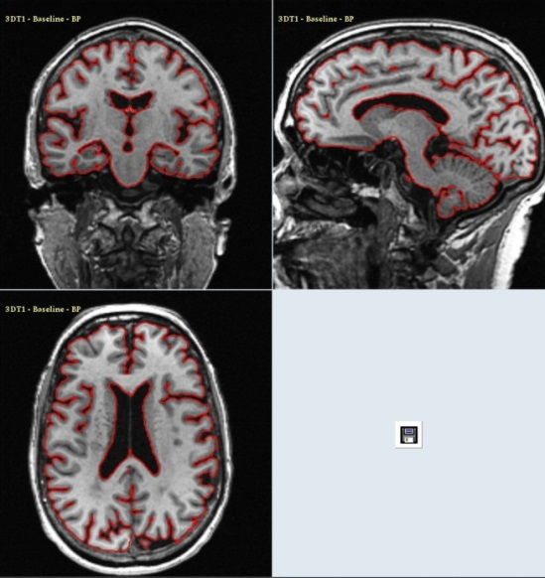
Image Quantification Methods
Intracranial Volume (ICV)
Hippocampal Volume (HCV)
Ventricular Volume (VV)
Whole Brain Volume (WBV)

Slide 17
Imaging in Clinical Research: Radiology Departments
Imaging CROs have to interact with Radiology Departments where various key actors provide technologies and services:
Manufacturers of medical image acquisition systems (MRI, CT, PET, US)
General Electrics, Siemens, Philips, etc.
Providers of PACS (Picture Archiving Communication Systems) solutions: ability to manage, archive, share, visualize and transmit medical images
Carestream, Sectra, McKesson, etc.
Software editors providing additional (more advanced) image analysis solutions to radiology departments, integrated to existing PACS systems
Median, Intrasense, Keosys, etc.
Providers of Hospitals Information Systems (RIS) where data collected from different departments are integrated into a unique system
Providers of Teleradiology services, involving remote reading services (secondary referral or completing human resources)
Carestream, Etiam, etc.
List of Exhibitors, Journées Françaises de Radiologie http://jfr.radiologie.fr/exposants-2013

Slide 18
Imaging CRO Market (1/3) Key Evolutions between 2001 & 2014
Improvement of image quality
Increased diagnostic value
Higher data resolution
Faster acquisition (patient’s comfort, less impacted by movement artefacts)
Use of advanced image analysis techniques
More complex image analyses methods (require more computing power)
Acceptance by regulatory agencies of more quantitative/objective imaging biomarkers as exploratory, key secondary or sometimes primary efficacy endpoints
Challenges: validation of new biomarkers and qualification/acceptance by regulatory agencies
Imaging used to detect subjects who may better respond to a given treatment
Imaging used to better monitor safety

Slide 19
Imaging CRO Market (2/3) Key Evolutions between 2001 & 2014
Image management and transfer
Image data sent from clinical sites to imaging CROs using the internet (but CD still remains an important medium)
Usage of cloud platforms and web-based image analysis services
Challenges: security and regulatory compliance

Slide 20
Imaging CRO Market (3/3) Key Evolutions between 2001 & 2014
Clients are increasingly cost conscious
Pricing pressure: pharmaceutical companies require important savings for large research programs and non-differentiating services
“Master Services Agreements” and “Rate Cards”
Regular RFI processes to identify preferred vendors every 2 to 3 years
Competition
Competition among market leaders (BioClinica, Perceptive Informatics, ICON), smaller companies (Virtual Scopics, Ixico, ACR Image Metrix, Biomedical Systems, Biospective, NeuroRX) and prestigious academic labs providing image analysis services to pharmas (historical examples, in MS)
Technology remains main differentiating factors in a highly competitive environment
Innovative services, rich catalogue of new imaging biomarkers, lower costs while preserving data quality and integrity, scientific expertise

Slide 21
Thank You! http://www.bioclinica.com/ http://www.bioclinica.com/about/careers
Chahin PACHAI, Ph.D.
Chahin.pachai@bioclinica.com
+33 (0)6 13 55 14 04

