Slide 1
State of the Art in Imaging in Research and Development - Pharmacology
Mark E. Schmidt
Experimental Medicine

Slide 2
Personal background
Graduate: MD University of Chicago 1983
Residency: General Psychiatry US Navy 1987
Fellowship Clinical Pharmacology NIMH 91-97
Clinical Research Physician Lilly Research Labs 97-2001
Senior Director Clinical Imaging Biomarkers Novartis AG 2001-2005
Senior Director Experimental Medicine Janssen NV 2005-present
Neuroscience preclinical imaging team leader
Preclinical DKI MRI IWT O&O investigator
Clinical expert for PET imaging in Alzheimer’s disease
Janssen liaison to the Alzheimer’s Disease Neuroimaging Initiative (ADNI)
Clinical leader for early development of NMEs for the Mood and Alzheimer’s disease area strategies.

Slide 3
Current collaborations and activities
PET radioligand discovery for neuroscience
University of Leuven Laboratory of Radiopharmacy
PET imaging of translational models for Alzheimer’s disease
University of Antwerp/Molecular Imaging Center Antwerp (MICA)
Innovatie door Wetteschap en Technologie (IWT) Onderzoek en Ontwikkeling (O&O)
University of Antwerp Bioimaging Lab
Diffusion kurtosis MRI in transgenic b-amyloid and tau pathology models
University of Leuven Laboratory of Radiopharmacy
Tau PET ligand
Blood brain barrier and transporter function
Stellar
Free University Amsterdam
Tau PET (clinical)
ADNI PET Working Group

Slide 4
Why Use Imaging as for Pharmaceutical Research and Development?
Can we detect? Expression of the target and/or activity of the pathway
Are we achieving? Potent target tissue exposure
Can we observe? Activity on the molecular target
Can we measure? Modulation of the desired biochemical pathway
Can we demonstrate? The desired biological effect
Does all this translate? To disease response
Paul Workman

Slide 5
Performance Characteristics of Clinical Imaging Methods
Imaging Method | Temporal resolution | Spatial resolution | Sensitivity | Energy ΔE=hν
MEG | 1 msec | 5 mm
EEG | 1 msec | 10–15 mm
MRI | 100 msec single slice 3 sec multiple slice | 3.5 mm† 1-2 mm‡ | 10⁻⁵ molar | 10⁷ Hz
PET | 45 sec* 20 min** | 6.5 mm* 4 mm** | 10⁻¹² molar | 10¹⁷ Hz
SPECT | >60 sec | 6–8 mm | 10⁻¹² molar | 10¹⁷ Hz
† GE BOLD 1.5T * H₂¹⁵O to measure CBF
‡ SE-BOLD 7T **¹⁸FDG to measure CMRglu
Adapted from: Farde, Rosen, Volkow PNAS 1997
Logothetis Nature 2008
5

Slide 6
Why PET Imaging in CNS Drug Development?
The sensitivity of the method allows:
Measurement and distribution of drug targets in vivo
Measurement of drug compound in the target tissue in vivo
Measurement of metabolic processes in vivo
Multiple isotopes allows:
Range of time courses for measurement
Flexibility in labeling small molecules and biologics
Readily translated from preclinical models to clinical application
Serial assessments are possible: humans and preclinical species can serve as their own controls
An accessible technology for clinical trials:
Hospital based
Increasing availability through adoption of PET for diagnosis and treatment
Increasing number of ¹⁸F labeled tracers
The challenge:
Site specific tracers for new mechanisms of action may need to be developed

Slide 7
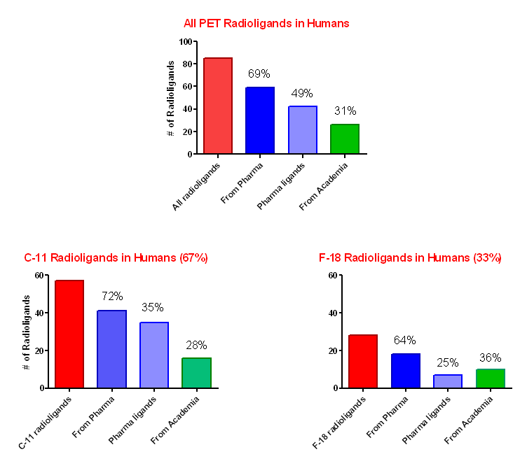
Origins of CNS PET Radioligands Taken Into Human Subjects
V Pike NRM 2012

Slide 8
Models for PET Ligand Development Used by Pharma
Low
Ad hoc development of ligands with academic centers based on request by PET center, no collaboration
Radioligand candidate selection by clinical candidate project team, then external collaboration with PET center
Radioligand candidate development by internal chemistry group, in vivo testing done through contract or collaboration with PET center
Radioligand candidate development, in vivo testing in-house
Control over:
Timeline
Intellectual property
Likelihood of technical success
Cost
High

Slide 9
PET Ligand Development Process
Clinical target portfolio entry
PET NME Declaration
PET First in Human
PET PoC
Discovery
Preclin. imaging
Quality control
PoC in HV
Clinical use
Beerse/Toledo/KUL
Beerse/KUL
Beerse/KUL
Beerse/KUL
Target selection and
initiation of project
Feasibility assessment
Tracer discovery
and characterisation
(chemistry,
pharmacology)
Initiated during HTL:
Allows the greatest diversity in chemical series, use of target screens and counterscreens
³H radiolabelling
PET radiolabelling
Ex vivo/in vivo distribution and competition
Kinetic modeling
Metabolism
Toxicology
Chem Pharm:
precursor synthesis, qualification of radiosynthesis
Registration dossier
Modeling and Analysis
Regulatory
Experimental Medicine/
Clin PK
PET used in
support of drug
development
(target distribution,
occupancy, PK,
efficacy)

Slide 10
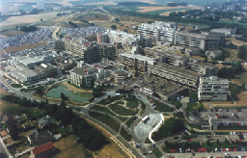
Quantification of ¹⁸F-JNJ42259152, A Novel Phosphodiesterase-10A (PDE10A) PET-tracer : Kinetic Modeling and Test-Retest in Human Brain
K Van Laere ¹, H Hudyana¹, R Ahmad¹, K Dubois², M Schmidt², G Bormans³ and M Koole¹
¹ Division of Nuclear Medicine, University Hospital Leuven, Belgium
² Janssen Pharmaceutica R&D, Beerse, Belgium
³ Laboratory for Radiopharmacy, KU Leuven, Belgium
³
SNM Annual Meeting, Miami, Florida 2012

Slide 11
Phosphodiesterase 10A (PDE10A)
Cyclic nucleotide phosphodiesterase superfamily
Dual substrate enzyme: hydrolization of cAMP & cGMP (Fujishige et al. 1999; Bender et al. 2006)
Coupled to D2 and D1 dopamine receptors
Restricted distribution in the human body (Seeger et al. 2003)
- Brain : >> Striatum
< Substantia Nigra
<< Nucleus Accumbens
<< Tuberculum olfactorium
Central role in striatal (cAMP/PKA) signaling : cAMP activates PKA which is responsible for phosphorylation of various intracellular targets (eg. DARPP-32) altering cellular function (Surmeier et al. 2007)
Implicated in several neuropsychiatric disorders
Schizophrenia (Siuciak et al, 2006), movement disorders (Huntington’s disease) (Hebb et al, 2004), addiction (Menniti et al, 2006)
Treatment potential of PDE10A inhibitors

Slide 12
PET tracers for PDE10A
Previous ligands ?
¹¹C-papaverine (Tu et al. 2010): rapid washout from CNS
¹¹C-MP10 (Tu et al. 2011): BBB penetrable radiometabolite
2-[[4-[1-(2-[¹⁸F]fluoroethyl)-4-(4-pyridinyl)-1H-pyrazol-3-yl]phenoxy]methyl]-3,5-dimethyl-pyridine
MW=401.46
Affinity : pIC50=8.79 ± .01
Selectivity for PDE10A: 1000-fold over other PDE subtypes, no other targets below μM level
Plasma protein binding ≈ 99.5 %
¹⁸F-JNJ42259152

Slide 13
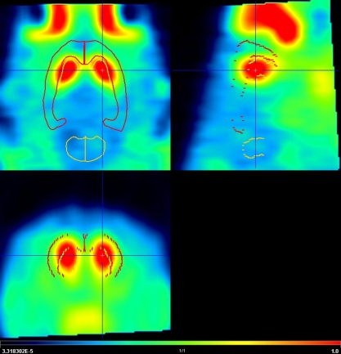
[¹⁸F]-JNJ42259152: PET Ligand for PDE10
Before chase JNJ302 (10 mg/kg)
Chase
vehicle
Vehicle or
JNJ302 (2.5 mg/kg, i.v.)
Chase
JNJ302
2.5 mg/kg
After chase JNJ302 (10 mg/kg)
Complete displacement of PET ligand [¹⁸F]JNJ152 after administration of
JNJ302 (2.5 mg/kg i.v. chase)
Notes:
M0005176: F18-JNJ152: Chase studie met JNJ302 30 min post tracer injectie , iv, dosis 0; 2.5;10 mg/kg n=3 (isoflurane)
Dynamisch 120 min
M0005176 /
F18-JNJ152
Gewicht (g)
Inj dosis (mCi)
Vervolg
Rat 1 nieuwe jonge
292
1,88
OK
Rat 2 nieuwe jonge
284
1,86
OK
Rat 3 nieuwe jonge
296
1,74
OK

Slide 14
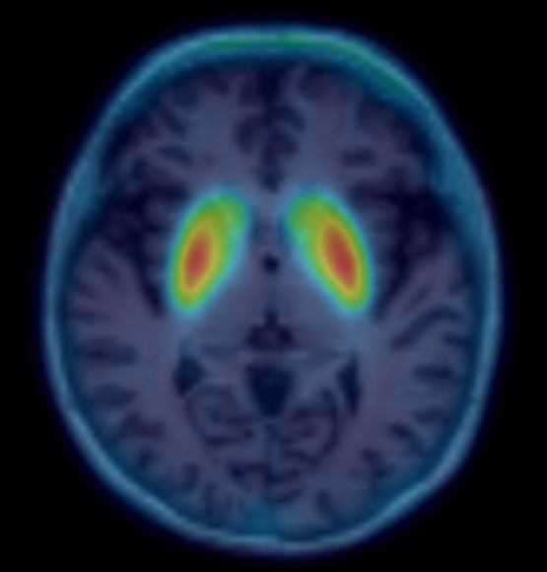
Results in Human

Slide 15
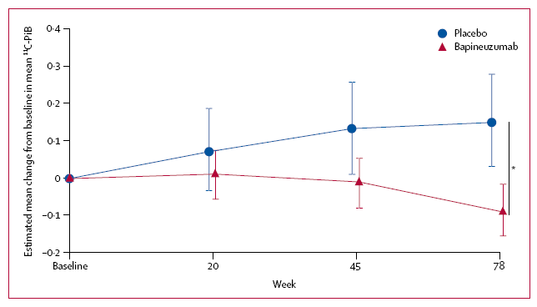
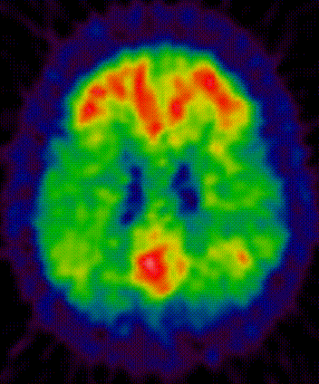
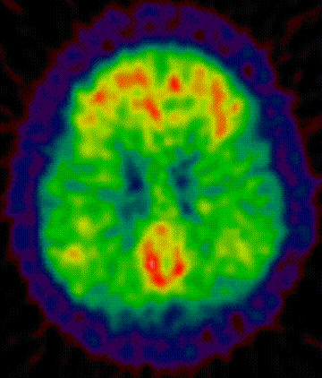
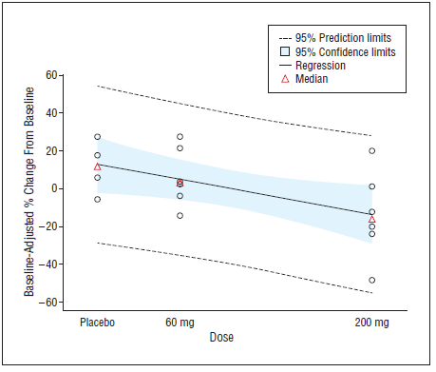
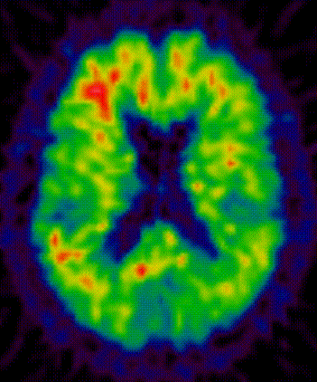
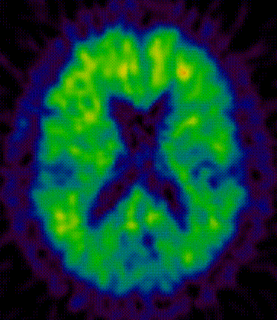
PiB PET as Treatment Endpoint in Clinical Trials of
anti-Aβ MABs
Screen
Week 78
Bapineuzumab (n=19)
Placebo (n=7)
-
-
0.09
A
0.09
A
A
A
A
A
Screen
Week 78
Gantenerumab (n=6/6)
Placebo (n=4)
B
B
-
-
0.33
B
0.33
B
B
B
Rinne et al, Lancet Neurology 2010
Ostrowitzki et al, Arch Neurol 2011
Notes:
15
As recently published in Lancet Neurology, using PIB PET technology, bapineuzumab treatment has been shown to reduce beta amyloid in people with mild to moderate AD.
Panels A and B show 2 different AD patients who were treated with bapineuzumab. Each panel shows the amount of brain amyloid as detected by PIB PET before initiating treatment and also at Wk78 after 18 months of treatment. There is reduction in brain amylolid both subjects after bapineuzumab treatment as detected by PIB PET.
The graph in the right hand panel shows the increasing amyloid reduction over time with bapineuzumab treatment (in red) and increase in amyloid burden in placebo treated AD subjects (in blue).
So this was very important research, part of a larger puzzle – which we’re continuing to put together piece by piece.
And that brings us to the new data that we’re presenting today.

Slide 16
¹¹C-PiB SUVR as a Longitudinal Measure: How well does it scale in multi-site trials?
Some subjects show trajectories not consistent with biological change and in excess of test-retest variability
Data from ADNI http://www.adni-info.org/

